Slide 1

Quality Assurance
Support Program
Dec 19th 2025
Arnout Andrews (AECL)
Adrian Hull (THS)

Slide 2
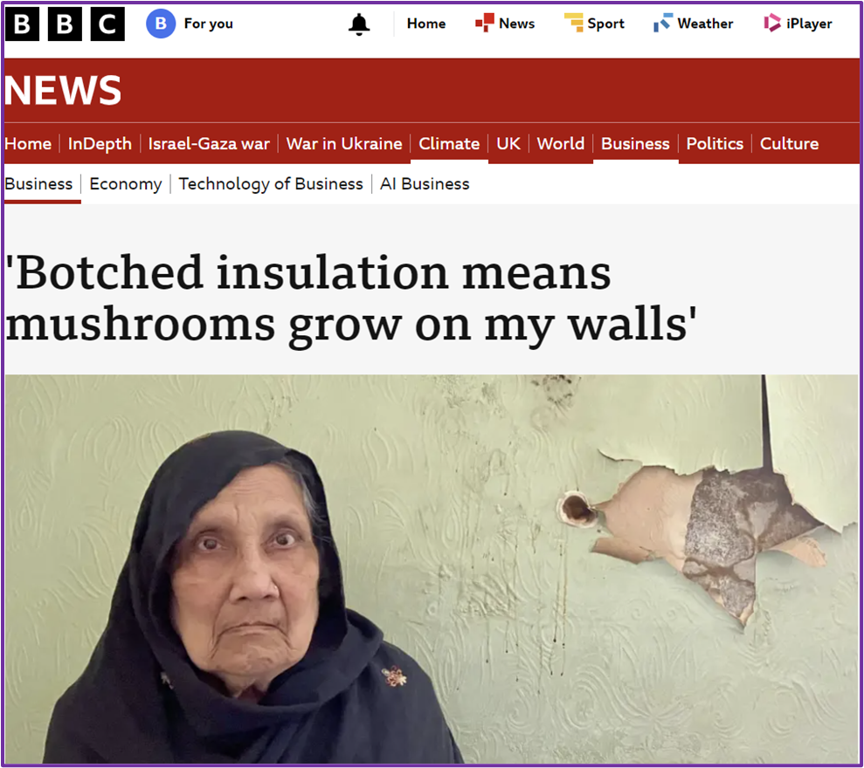

Contents
Rationale & Objectives
Support Program Overview
  ‘Introduction to QA & (Technical) Site Visits’ - sessions
  QA Mapping
  Technical Inspection Visits
  Materials
      Especially ‘Blueprint’
Possible what do you want / need
Today’s ask
Questions

Slide 3
Rationale / Objectives
Rationale
  Too many poor jobs in programs – means many risks
  Consortia context creates an opportunity to support more robust delivery!
Objectives
  Better knowledge and understanding:
    QA landscape
    Who should do what, when and how
    What can you do (How to improve) directly or indirectly?
  Facilitate improvement of MNZH consortia members retrofit project delivery – through improved QA
    Make improvement accessible and achievable with support.
    Stakeholders too!

Slide 4
Program Overview
Notes:
Targeted at SHF orgs – but other stakeholder welcome, esp’ LG and CJS

Slide 5
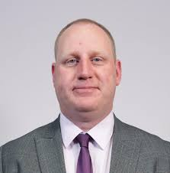
Intro to QA & Technical Site Visits: sessions
Two types
  QA & Site Inspections General Intro sessions
  Measure Specific Intro sessions
Led by Adrian Hull
  Director and former Chair of ATMA ( https://atma.ltd/ )
  Owner of THS Inspection Services Ltd ( https://www.ths.ltd/ )
  Former BSI PAS Steering Group Member (PAS 2035 and PAS 2030)
  Consultant to Ofgem – Compliance and Health and Safety for Innovation Measures (TAP Panel)
  Delivered over £1.2bn household energy efficiency measures
  Supply chain management of £350m per annum National Scheme
Virtual Sessions probably c.2 and a half hours.
  Relatively small to allow engagement; interactive; responsive
1st General session in Feb – dates soon.
Talk to us
We will collect feedback on measures @MNZH, Jan 29th

Slide 6
Intro Session Content
QA & Site Inspections General Intro sessions
  Looking at the what, why, how, who of QA. Including PIBI’s, pre, during and post works inspections.
Measure Specific Intro sessions
  These sessions will focus on a specific measure[s] and walk through the process including key issues for that measure.
  Feedback from you will steer what we do first!

Slide 7
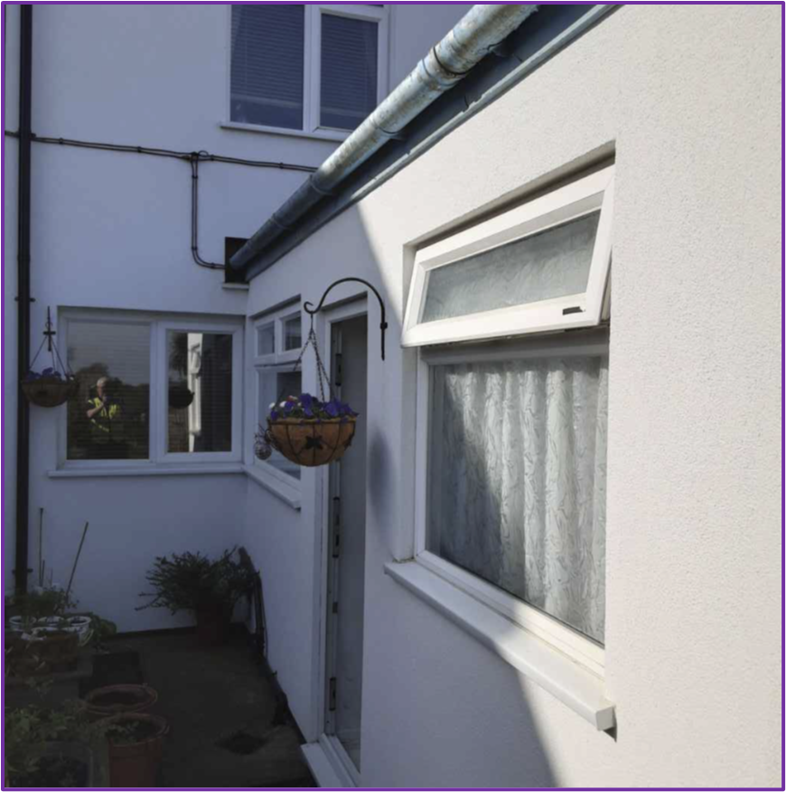
Mapping & Guidance
Primarily in-person (but can be remote if required).
Mapping
  A review of the QA & Technical Site Inspections in your project.
  How much is being done by who and at what stages?
  Think – a simple grid. R.A.G. rating all the elements – see next slide.
    But lots of potential detail underneath.
Guidance
  Organisation specific – prioritised ‘next steps’
  Informed by the mapping exercise
  Route to success

Slide 8
Mapping (Basic Concept)

Slide 9

Technical Inspections
Opportunity for every MNZH Consortia member to have an independent technical inspection – and report.
Before, during, or post
Optimising learning and benefits
  Working with installers
  Shared learning (different measures and different times)
  Recommendation to complete these early in programme

Slide 10
Materials
Blueprints
  ‘Minimum’ and ‘advanced’ model QA framework.
  Sharing of results and outcomes for learning
  Things to look out for or request
    Competence; Accreditation and registration; Inspection scope; Evidence; Remediation and re-inspection.
Possible materials
  Examples; Case Studies; Templates; Videos?
https://www.andrewsenv.co.uk/mnzh-materials/

Slide 11
Today’s ask
We will gather measure information at the MNZH Event on Jan 29th
We will come back and present some outputs / outcomes in Q1 next year.
Does anybody think that they might be interested in:
  Mapping and Guidance
  Technical Inspection Visits
Put something in the chat…
  Possibly including what specifically
Email me if you are very keen! arn@andrewsenv.co.uk

Slide 12

Talk to us!
What do you want / need?
Let us know!

Slide 13

Any Questions?

