Slide 1

Monitoring & Evaluation Support Program (Building Performance Evaluation [BPE]) Nov 7th 2025
Arnout Andrews (AECL)

Slide 2

Contents
Support Program Overview
‘Introduction to Performance Measurement’ Sessions
Handholding Into Monitoring
Doing your own monitoring projects
Materials
Possible case study project
Today’s ask

Slide 3
Program Overview
Program Overview
Notes:
Targeted at SHF orgs – but other stakeholder welcome, esp’ LG and CJS

Slide 4

Intro to BPE sessions
A series of in person sessions in homes
With Zack Gill (and Arn)
Main author of BS40101
SOAP Retrofit (https://www.soapretrofit.com/)
Hands on day, for c.6 organisations each session.
Content
Intro; RdSAP; HTC & U-values; Airtightness; Ventilation
(Other possibilities Boroscope; Damp meter; Thermal Imaging)
1st session pencilled in for Dec 3rd tbc.
AT LEAST 1 further session in West Mids
Others – if demand

Slide 5
Handholding into Monitoring
Supported ‘learning by doing’ - Having a go at measuring something.
e.g. HTC (but could be any form of monitoring)
I will come to you and we will do some introductory work on HTC, and we will go out and install Smart HTC kit in a home or two.
I will come back in c.3weeks, we will remove the kit and upload the info to the platform and look at the results.
WHY?
Support members understanding of BPE: kit, costs, methods resources, etc.
Remove barriers to members undertaking BPE.

Slide 6
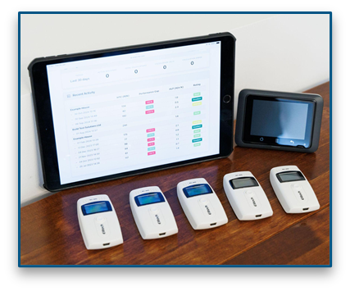
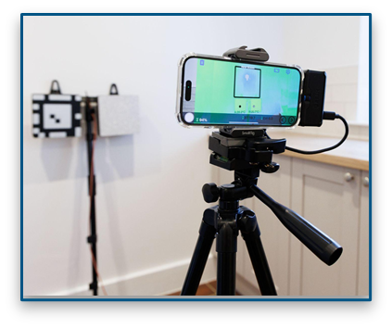
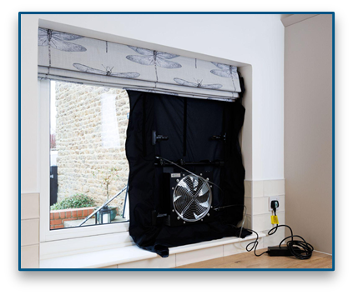
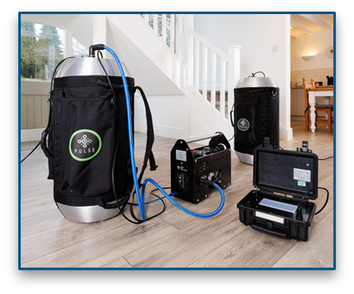
Doing your own projects
MNZHub is planning to purchase equipment which may be borrowed by consortia members to do their own projects. Tbc
But there will be at least some equipment available!!
Images from BTS

Slide 7
Materials
Subjects
Occupier questionnaires; Smart HTC, HLP (building envelope thermal performance); U-value measurement [Heat-3D]; Airtightness; Ventilation; Thermal Imaging; Damp Meter use; Boroscoping
Others
PV; Heat Pumps
Possible materials
Does the existing ‘material’ really help?
Manuals, instructions, guides, how to videos, user training, accredited training, examples, templates, Case Studies.
If so, put materials and links on the website with helpful steering.
If not produce these materials!
Helping organisations might help to produce some of these materials…
https://www.andrewsenv.co.uk/mnzh-materials/

Slide 8

Possible Case Study project?
Undertaking monitoring projects for you is not in the scope of the AECL support. But…
We might possibly do some of this to help create materials – so it is worth talking to us on this!

Slide 9
Today’s ask
Any interest at this point in:
Introduction to monitoring sessions?
tbc Nottingham 3rd Dec tbc.
Intent to do a West Mids one
Might do a MNZH Staff one
Others by demand.
Handholding into Monitoring support?
Might be available from as early as 17th of November!
Thermal envelope (HTC HLP); U-value measuring; Airtightness, and pathways; Ventilation; Damp meters; Boroscoping; Thermal Imaging; Occupier Questionnaires?
Others? PV, Heat Pump performance.
Put something in the chat…
Possibly including what specifically
Email me if you are very keen! arn@andrewsenv.co.uk

Slide 10
Any Questions?

