Slide 1


Slide 2

Heat Pump Installation Projects for Social Housing
Lessons Learned and
Roadmap for Improvement

Slide 3

Introductions
Matt Jones. Bristol City Council
Ruzanna Chitchyan and Sam Gunner University of Bristol.
James Gallie, BWCE
Supported by Jack, Carbon Trust and Codrina from Nesta

Slide 4
Outline of the day
Short background to work (15 mins)
Pre installation: what we learned, recommended actions, key takeaways (15 mins)
3. Questions and Discussions (10 mins)
LUNCH (1 hour approx)
Design: what we learned, recommended actions, key takeaways (15 mins)
Installation: what we learned, recommended actions, key takeaways (15 mins)
Post installation: what we learned, recommended actions, key takeaways (15 mins)
Questions and Discussions

Slide 5
Heat Pump Installation Projects
for Social Housing
Lessons Learned
and
Roadmap for Improvement

Slide 6
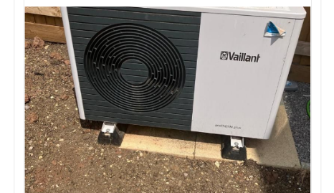


Where it all started....
Found that demand is low for heat pumps
Perhaps this is why!
Notes:
Like everyone we have carbon reduction targets and heat pumps are a big part of that plan
At the time we were focused on how to accelerate heat pump deployment at high density but found that people didn’t want them at the scale we expected even with really good offers and lots of community engagement
Through a DESNZ funded Heat Pump Ready project we got to know a few of the local installers as part of the work who began to highlight some poor installs they had seen so we went to investigate

Slide 7
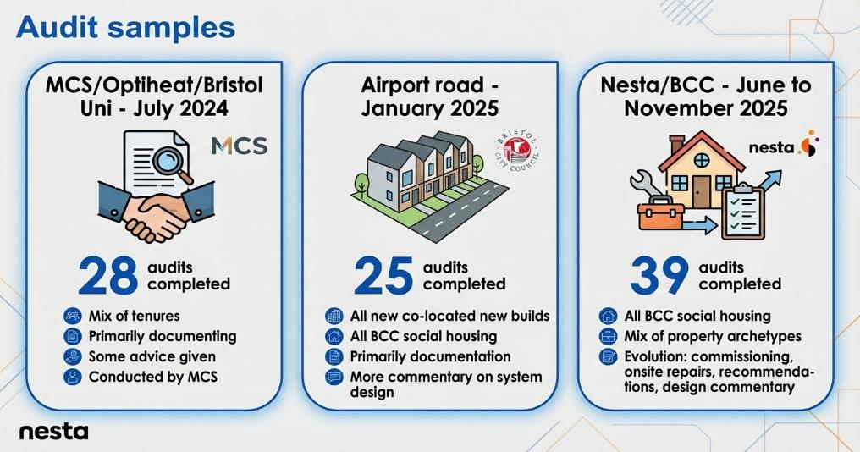
Notes:
We decided to do some audits to investigate
Engaged local heat geek trained installers to help us do audits, though that isn’t their core work and often don’t want to touch other people’s installs
MCS were involved in doing first set of audits who we have continued to engage with
Included new builds, social housing and some private properties
Can you get what % of properties were found to have issues?

Slide 8
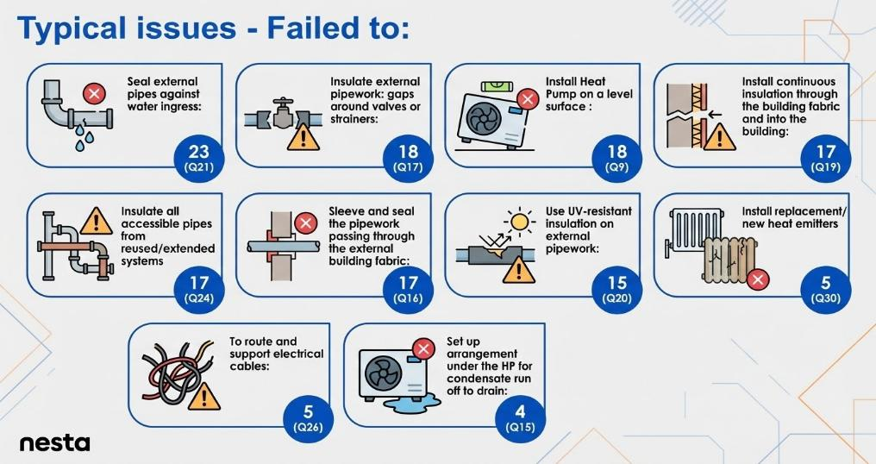
Notes:
Commissioning poor and lagging key issues

Slide 9
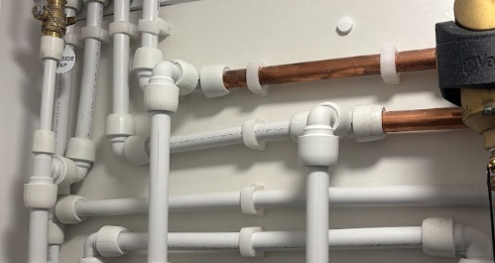
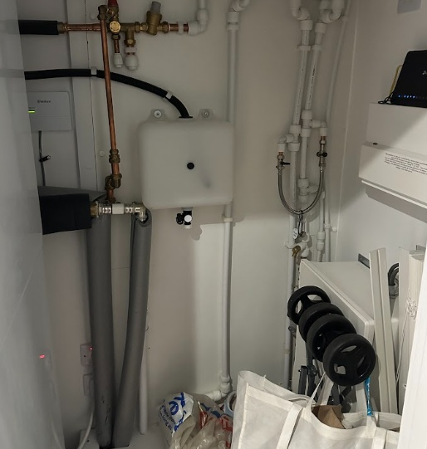
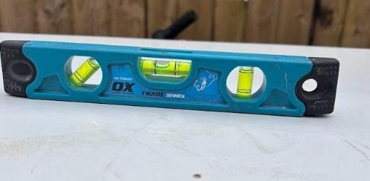
Notes:
You don’t need to be a heat pump expert to see this looks a mess

Slide 10
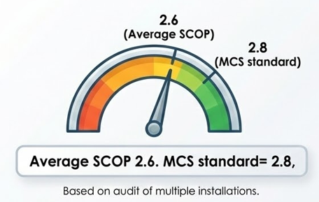






54% costlier to run!
4.0
Gas parity
Notes:
A poorly installed heat pump might be 50% or more expensive to run compared to a good one
A poorly installed heat pump is more of a maintenance liability both from earlier end of life and increased resident call outs
A heat pump with SCOP 2.6 costs ~54% more to run than one with SCOP 4.0 at current Ofgem electricity prices
1. Annual electricity consumption
$$\text{Electricity}\text{ use}=\frac{\text{Heat demand}}{\text{SCOP}}$$
SCOP 2.6
$$\frac{12,000}{2.6}=4,615.38 \text{kWh}$$
SCOP 4.0
$$\frac{12,000}{4.0}=3,000 \text{kWh}$$
2. Annual heating cost
Using electricity cost £0.2769 per kWh:
SCOP 2.6 cost
$$4,615.38×0.2769=£1,278.30$$
SCOP 4.0 cost
$$3,000×0.2769=£830.70$$
3. Percentage difference
$$\frac{1278.30−830.70}{830.70}=0.538=53.8\%$$

Slide 11

Medium usage
Gas disconnected
Low usage
Gas disconnected
High usage
Gas disconnected
3.3
3.1
3.5
Smart tariffs?
Average SPF
2.7
All usages
Gas connected
4.0
Low efficiency
Medium efficiency
High efficiency
Smart Tariffs can change the game!
Notes:
The target scops can be improved with removal of standing charge and using smart tariffs

Slide 12
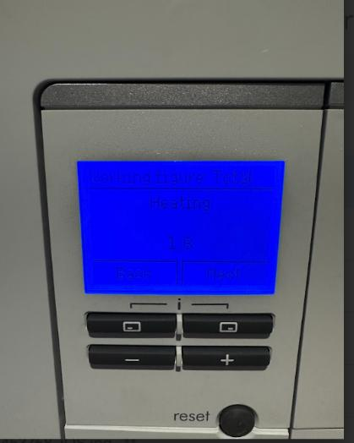
SCOP
Notes:
This is the reality for some installs out there, this was the scop for the images I showed previously

Slide 13


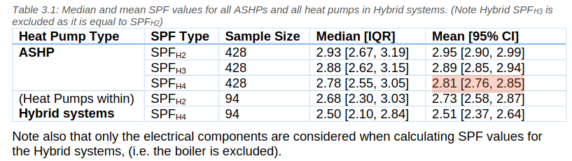
Heat pump in situ performance: a national issue
https://es.catapult.org.uk/report/electrification-of-heat-summary-reports-and-datasets/
EOH DATA Open Energy Monitor
Average SCOP 2.8
Notes:
- Electrician of heat project had over 700 installs with an average scop similar to ours
- I know that some remedial works were done before that final scop figure was measured so in reality it was actually worse
- Audits were also done on a sample of these which showed lots of similar issues to what we found
means that it’s highly likely that any existing or planned installations will have the same issues
So this is me sounding the alert

Slide 14
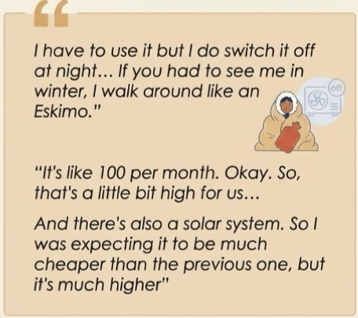
Experiences of social housing residents
Bills are high and a big concern
Mild concern through to not using the heat pump at all
No support with choosing tariffs and providers
Notes:
Interviewed residents alongside the technical audits

Slide 15

Experiences of social housing residents
Handover is poor
No explanation of how to best use the heat pump
"Don't touch it" instructions
Notes:
Experiences often driven by poor handover

Slide 16
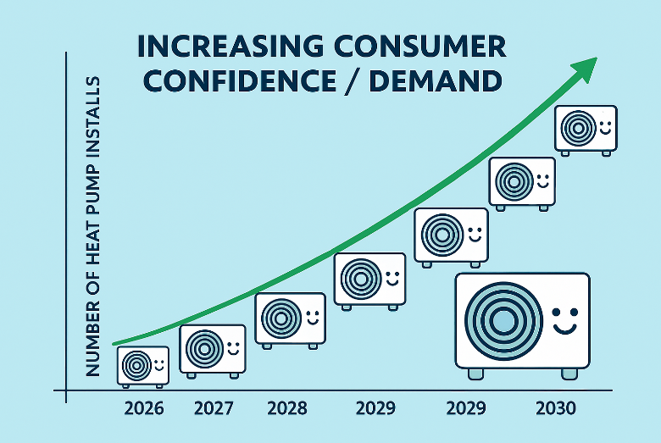
Notes:
It’s important to get right so we can build confidence and install numbers therefore meet our climate change ambitions
Happy heat pumps = happy customers who spread the good news

Slide 17
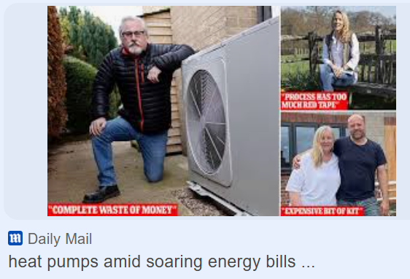
What happens if we don't get it right...
Heat Pump Fail
Notes:
Poor quality installations feeds the bad news cycle.
Plenty of Nay Sayers
Even if one or 2 fail it tarnishes the other successful ones

Slide 18
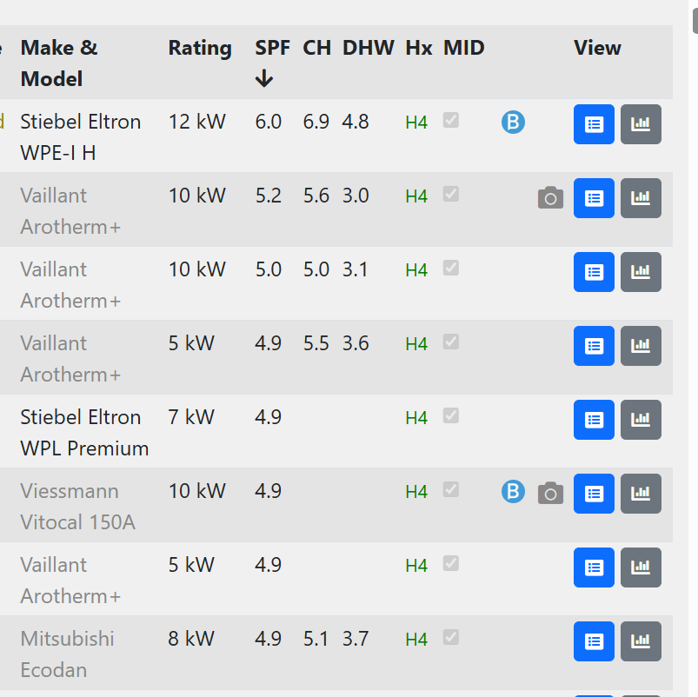
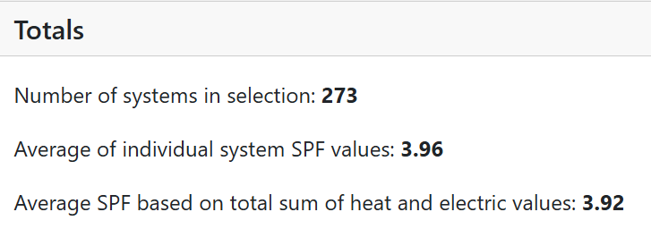

Notes:
But there is hope!
We know this isn’t a technology issue it’s a skills gap issue amongst everyone involved.
We know heat pumps can work really well and have the evidence for this from heat pump monitor website

Slide 19
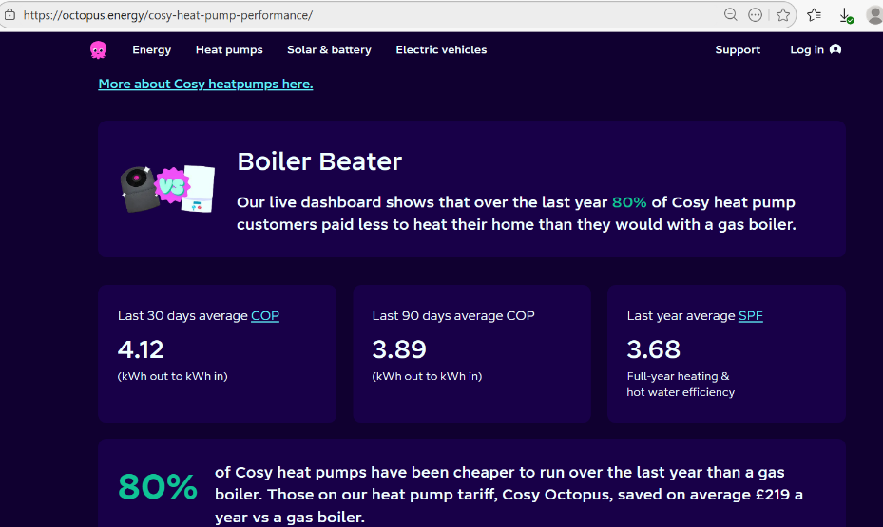
Notes:
Octopus have recently launched a dashboard as well showing savings of over £200 per year on average.
They do generally fairly cheap installs so this is encouraging.
Shows the importance of smart tariffs

Slide 20
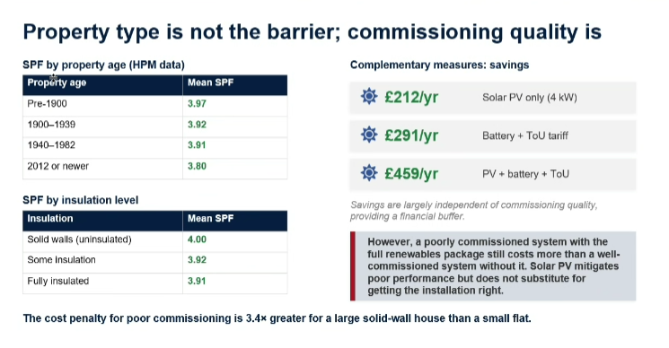
Notes:
The heat pump monitor data set also shows insulation levels is less important than quality of installation

Slide 21
Myth busters
Heat pumps work in nearly all buildings, laws of thermodynamics
There is no magic bullet to make people want heat pumps more
They are loud, same as a fridge (have you listened to a gas boil flue?!)
Heat pump fact check - Energy Saving Trust
Notes:
Through our work to date we’ve learned a lot and can bust these key myths

Slide 22

Fear not
there is hope!
Notes:
One good installer once said to me, don’t tell anyone but it’s not actually rocket science to install a heat pump well
When was the first heat pump invented? 1857
This is not new technology and is everywhere around the world right now heating hotels to supermarket fridges
There is an issue of poor quality under our collective watch but there is hope!

Slide 23
Questions

Slide 24

Stages of installation: learning and recommendations
Pre-Installation
Design
Installation
Post-Installation
What we learned
Recommended Actions
Key Takeaways

Slide 25
Pre-installation
Notes:
So this is the preparation stage so includes procurement and setting up how we are going to manage projects.
Might include recruitment of staff to delivery team roles including clerk of works

Slide 26
Pre installation: What we learned
Lack of skills in heat pumps ​amongst delivery teams
No detailed specification for retrofit or new builds​
Disparate approaches across different teams ​
Lack of tools used to help the management of projects
MCS/ Trustmark heavy reliance for quality assurance

Slide 27
Pre installation: Recommended Actions
Action 1. Establish the Organogram of Officers
Action 2. Understand current skills/ knowledge
Action 3. Set up a Heat Pump Working Group
Action 4. Undertake Heat pump training: technical non technical
Action 5. Find a good installer
Notes:
Five recommended actions here to work through

Slide 28
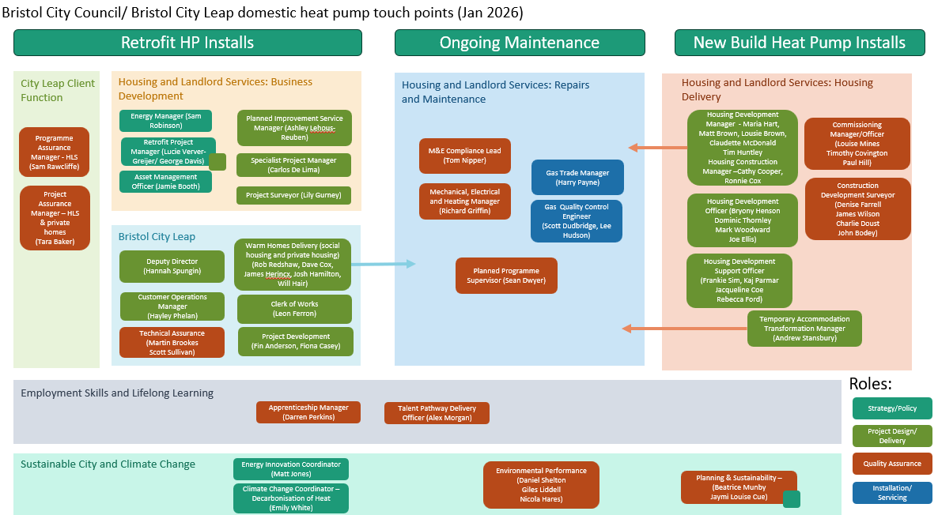
Pre
Installation Action 1:
Create
Organogram of Officers
Notes:
Firstly it’s important to understand who does what within your organization
Here’s ours which is quite complex so you can see why it’s important to map

Slide 29

Pre Installation Action 2:
Understand Current skills/ knowledge
Notes:
Once you’ve mapped these people
Ask about their knowledge and skills around heat pumps
Just a reminder: They don't need to be able to install one but they do need to know what good looks like

Slide 30

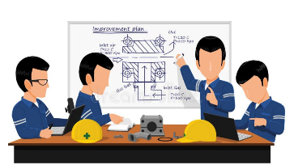

Pre Installation Action 3:
Set up the Heat Pump Working Group
Notes:
The heat pump working group could be a good place to consult and map skills
Critical to join up comms internally and share good practice
We have 80 people on a mailing list that could attend
We get about 20-30 regular attendees
Meets monthly
Cross section of different teams
Have guest speakers to embed bitesize learning

Slide 31

Pre Installation Action 4:
Undertake Heat Pump Training
Notes:
It’s really important that everyone involved in heat pump delivery can identify the good, the bad and the ugly

Slide 32




Non- Technical Heat Pump Training
Key aims of the programme
Empower teams to oversee the design, delivery and operation
Raise quality standards at all stages
Effectively facilitate remedial works where needed
Format
1.5 days, in-person
Day 1 Classroom-based, with group exercises;
Day 2 Site visit to 1-2 local heat pump installations.
Share resources for onward learning and reference
Training enquiries www.greenregister.org.uk
Notes:
Designed a custom learning course with Green Register, there isn’t one already existing out there like this
Empower learners
Raise standards
Facilitate remedial works
Format
Resources collation
Green Register are keen to work with others to develop the training further if there is any interest

Slide 33


Pre Installation: Heat Pump Training: technical
Notes:
You many have heating engineers within your maintenance or possibly internal install teams so understanding their skills is important and also signposting to good training
We are booked on with Warmur academy for the day but also recommend heat geek.
National Trust delivery teams are heat geek mastery trained

Slide 34
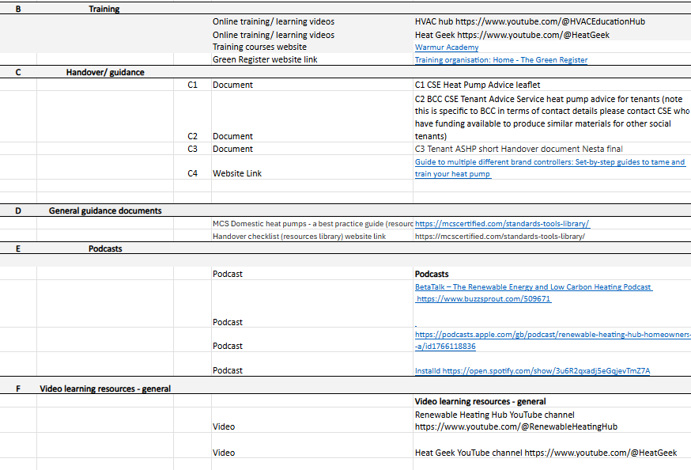
See: Optiheat List of Resources for training
Notes:
We’ve listed some good learning resources in our resource pack so just a reminder to look over that as a starting point

Slide 35
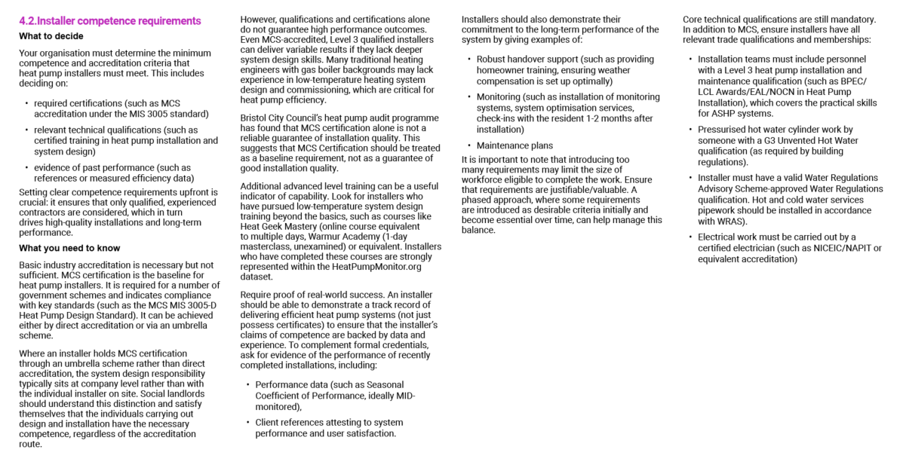
Pre Installation Action 5:
Find a good installer!
Notes:
Our guidance documents spell out what to look for in good installers
Public sector procurement can often restrict the best installers from engaging, entry barriers are too high
Layers of subcontracting erode margins and lead to tight margins for installers/ attracting incompetent ones

Slide 36

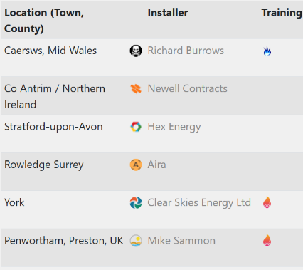
Place to Start
Notes:
Heat geek is not a bad place to start
Look on heat pump monitor for local installers

Slide 37



Key takeaways
1. Taking responsibility for your own learning is critical
2. Important to understand existing organisational competencies
3. Building strong relationships between internal stakeholders can help lay foundation for chance to take place
4. Invest in understanding how to find the best installers
=
Notes:
Self driven learning is key
Lack of knowledge amongst senior managers to identify training needs of delivery teams
Critical to understand existing competencies
Build strong relationships to achieve by in to change required
Try and find the best installers but without failed procurement, bronze is ok

Slide 38
Questions

Slide 39
Design
Notes:
By design we mean the stage where you start to get installation designs through from your appointed contractor and you need to agree and sign them off

Slide 40
Design: What we learned
Lack of detailed specification for installers
Often poor system designs are the foundation of poor-quality installs
Lack of skills to check designs amongst delivery teams
M&E consultants often the worst designers
Lack of heat loss calculations to size heat pumps correctly

Slide 41
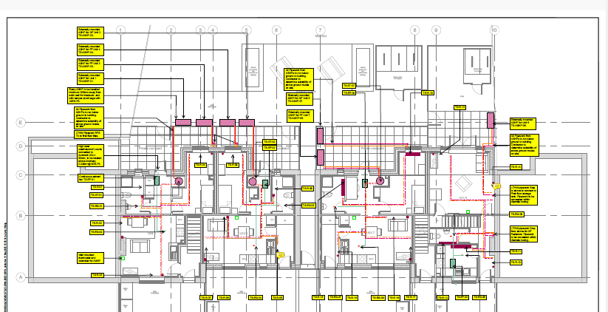
Notes:
? Where do you start trying to figure out whether this is correct or not?!
It really doesn’t help when information is provided in an inaccessible and inconsistent way

Slide 42

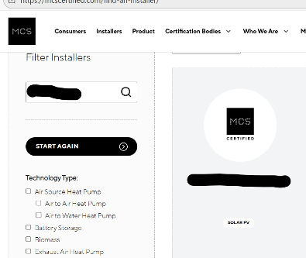
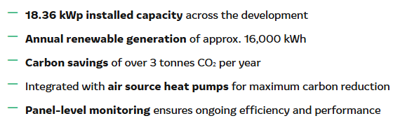
Why is bad design happening?
Notes:
Why is bad design happening?
At one sight we audited I looked in to the installers and found they had MCS listed on their website but this was only for Solar
New build sector particularly bad for poor system design

Slide 43
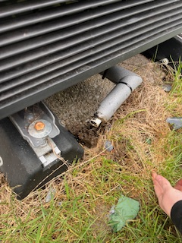
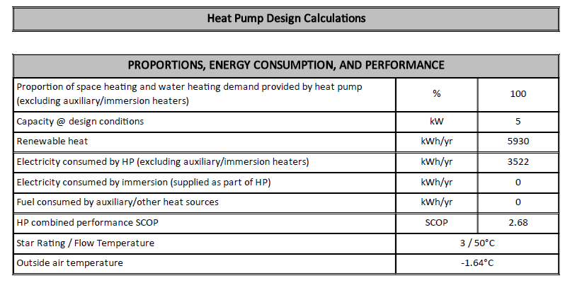

Bad design…Bad install
Notes:
SCOP lower than MCS even
And sure enough this led to an awful installation, heat pump was propped up on bolts and soak away was jammed straight in to the mud!

Slide 44
Design: Recommended Actions
Action 1. Review and update existing specifications/ employer requirements
Action 2. Monitor the implementation of specification KPIs.
Action 3. Seek expert advise to check designs/ build internal skills

Slide 45

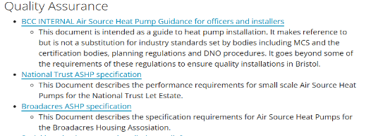

Design Action 1:
Review existing specifications
Notes:
We sought some expert input into our guidance and specification and thanks to national trust and broadacres have other examples to share.
Mostly based around MCS requirements but these don’t go far enough we think
We are working on an updated specification for Bristol to be more comprehensive taking learning from elsewhere as ours is currently more of guidance and specification

Slide 46

Heat Pump Guidance Doc
Notes:
Carbon Trust have put together a really helpful guidance document and tips on what to include in specifications which I highly recommend you read cover to cover
We recommend you use this document to help shape your specification and approach

Slide 47
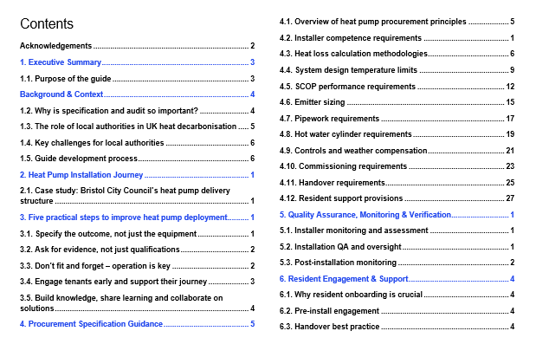
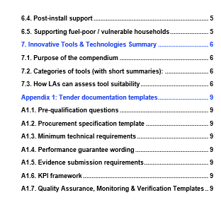
Table of Contents: Guidance Doc
Notes:
Reminder not for sharing as this is a sneak peak ahead of funder sign off

Slide 48
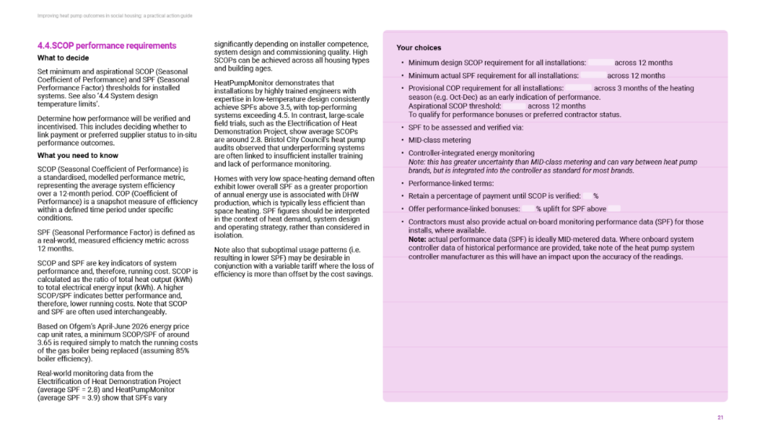

Notes:
This document helps understand what you need to know to make decisions and choices to implement
This example is for minimum performance requirements

Slide 49
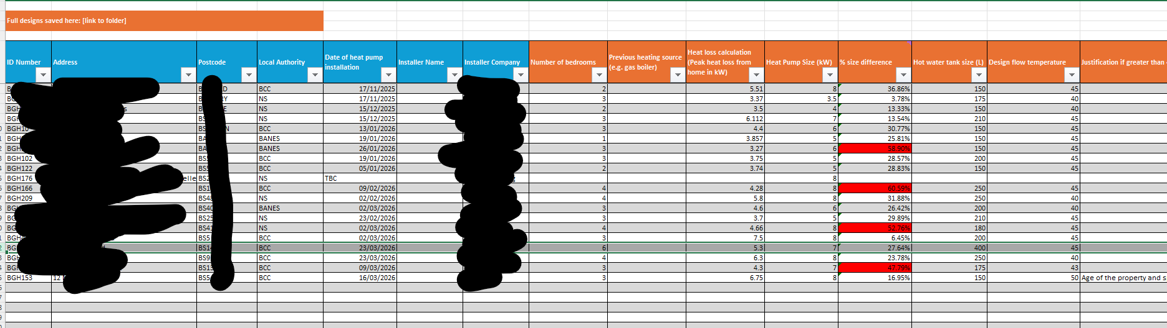
Design Action 2:
Monitor the implementation of specification KPIs.
Notes:
There’s no point have a specification if you don’t have something in place to monitor implementation

Slide 50
Design Action 3:
Seek expert advise to check designs/ build internal skills
Heat Geek/ Warmur academy trained a good start
Manufacturers can be a big help (free)
Asking installers to use consistent design tools e.g. Spruce etc (see guidance docs)
Notes:
We’ve found that retrofit coordinators and clerk of works often don’t have any expertise in heat pumps to undertake their roles
Big challenge to know who has the right skills
Manufacturers want to sell us lots of heat pumps so they generally are good at helping out with technical queries around design
Some manufacturers offer to indemnify the designs if put through them which is a good feature
Asking installers to use specific design tools can help with design quality assurance . We are working on a design checker tool as well to help non technical officers.

Slide 51
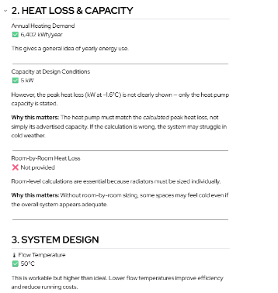

Design checker tool (in progress)
Notes:
Work in progress but we’re working with Nesta and Carno to produce an automatic design checker tool that could be helpful for others

Slide 52
Design: Key Takeaways
Guidance and specification critical at design stage
Need skilled individuals to quality assure this phase
Notes:
Having a good specification and guidance is critical for quality assurance and to create clear accountability
We need to have people managing the projects who know what good looks like or know who to ask to support this phase to save a lot of time and expense down the line

Slide 53

Nesta’s Installer Design Healthcheck
Scan the QR code to register your interest in future research and/or testing opportunities!

Slide 54
Questions

Slide 55
Installation

Slide 56
Installation: what we learned
Audit results show lack of competency amongst average installer
Poor design but also poor implementation
Commissioning of systems particularly poor in new builds
No monitoring or post install evaluation taking place
Notes:
You’ve already seen some of the audit results so we know there is an issue
Some systems have ok design but really sloppy install practices
Commissioning systems is one of biggest factors in heat pump system performance, weather compensation often not set
If we don’t monitor systems we don’t have any evidence base to learn from or solve issues with

Slide 57
Installation: Recommended actions
Self led non-technical 5 point checklist
Monitor each installation
Embed self auditing within the delivery process

Slide 58
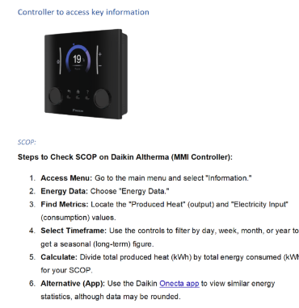
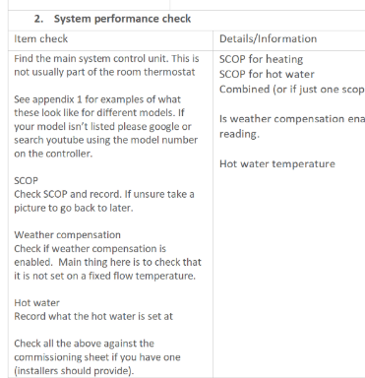
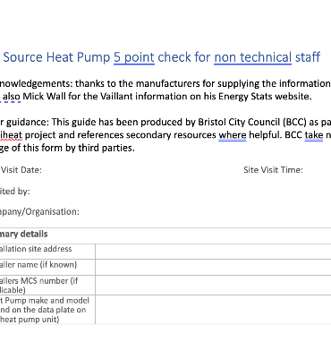
Installation Action 1:
Non-technical 5 point checklist
Notes:
We have a form in your resources pack to help non techy people check some basics about an installation
Recommend this is a first step for your own learning to go out and look at some heat pumps you have installed to assess basic quality
It is designed with a guide alongside so it instructs you how to seek the information required in form

Slide 59
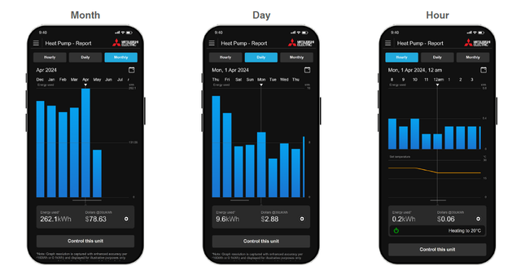
Installation Action 2:
Specify monitoring on each installation
Notes:
Without monitoring impossible to measure KPIs
Monitoring often comes with the benefit of providing more information to households as well if they are digitally savvy
Will say more about monitoring in next section

Slide 60
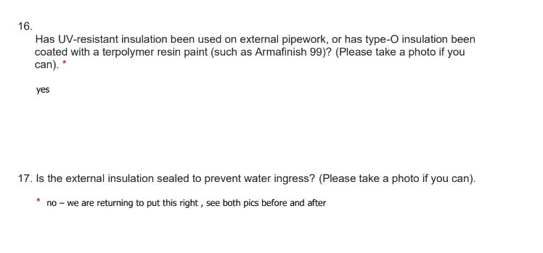
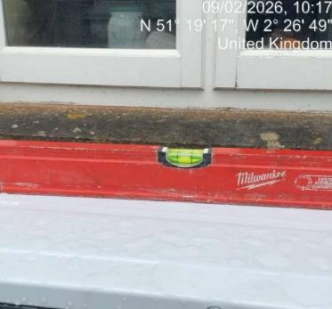

Installation Action 3:
Embed self auditing within the delivery process
Notes:
Already seeing the benefits of this approach with first audits
Probably takes the installer 30 minutes to complete on an online form but means it catches poor practices
You still need to check their work though, this picture of the level doesn’t show either end!

Slide 61
Installation: Key takeaways
Using the tools can provide a learning opportunity for yourselves e.g. 5 point check list
Monitoring is essential!
Installer self audit can save problems down the line
Notes:
Hands on learning is often the best with heat pumps, give the check form a try
Monitoring is essential
Installer self auditing can help mitigate against problems down the line

Slide 62
Questions

Slide 63
Post installation
Notes:
So this covers handover and critical things like auditing and monitoring

Slide 64
Post installation: what we learned
Handover often poor and not tailored to resident needs
Technical audits provide excellent insights
Skills gaps amongst support officers
Maintenance and Service teams skills gaps
Disputes with contractors difficult to resolve without monitoring
Notes:
Handover particularly bad on new builds
Technical audits really insightful and good at influencing senior manager to act
Found support officers often don’t feel confident to help residents if they don’t understand heat pumps themselves
Found skills gaps amongst service teams that could lead to voided warranties
Inevitable disputes with contractors are difficult to resolve without monitoring

Slide 65
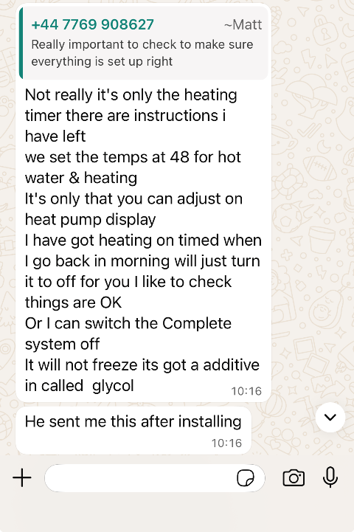
Handovers are often poor example …
Notes:
This was a warm homes local grant install done on a neighbours home.
I asked what his experience was as I saw the install was poor quality
I happened to bump in to the installer in the village…. Asked about why fixed flow
Handover might not even be done by the installer and is left to housing officers who don’t have the skills or info to do it properly

Slide 66
Post installation: recommended actions
Action 1: Handover review
Action 2: Undertake technical audits as standard on sample of installations
Action 3: Review maintenance regimes/ skills amongst technical teams
Action 4: Mandate monitoring on all installs

Slide 67

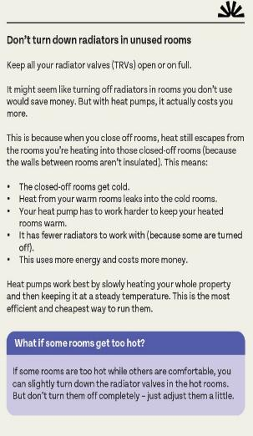
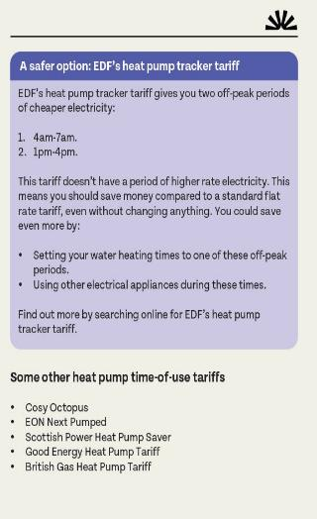
Post installation Action 1:
Handover review
Notes:
Nesta created a free online audit form in the resource pack you can copy and paste then adapt. It puts the output in to excel but then the guidance shows how to generate a report as well
It also covers a form for capturing any repair works done by contractors
So it should be ready to use and free

Slide 68
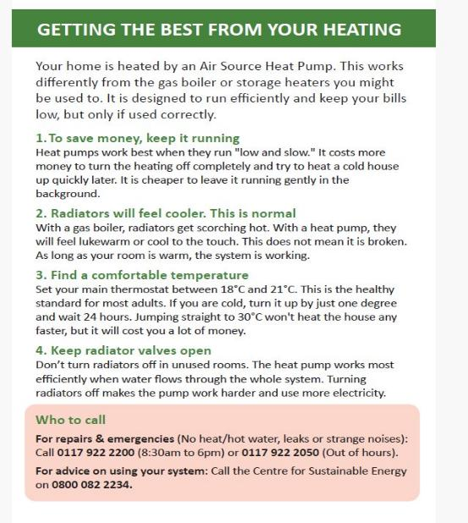

Notes:
We produced this short guide with Nesta as and designed a couple of helpful explainers for key concepts residents often struggle with

Slide 69
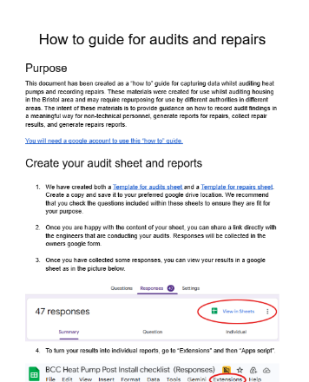
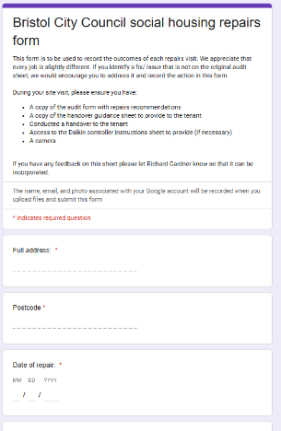
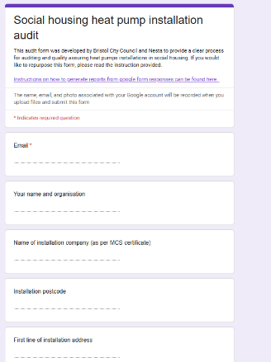
Post installation Action 2:
Undertake technical audits as standard on sample of installations
Notes:
We learned a lot during the technical audits.
Non technical and technical team shadowed the auditors and learned a lot
Nesta created a free online audit form in the resource pack you can copy and paste then adapt. It puts the output in to excel but then the guidance shows how to generate a report as well
It also covers a form for capturing any repair works done by contractors
So it should be ready to use and free

Slide 70
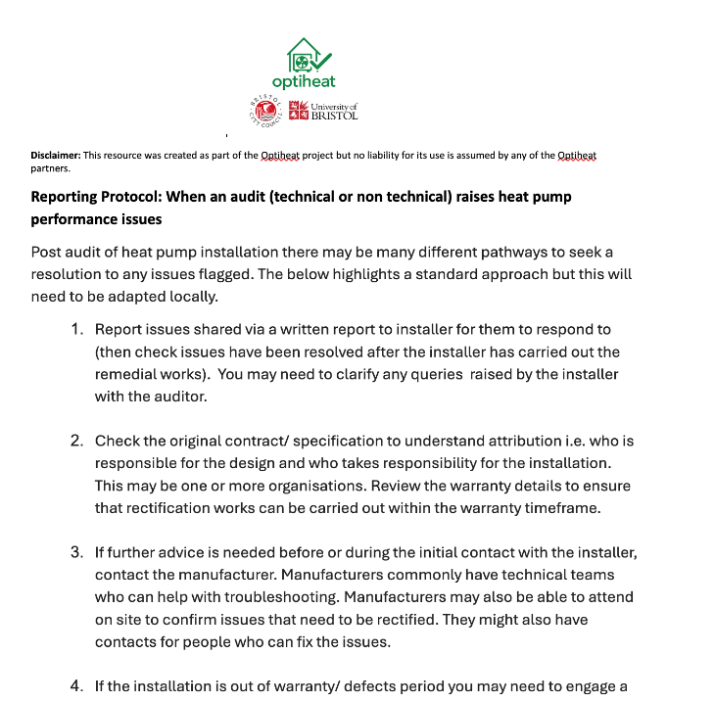
What to do if you discover issues…
Notes:
We’ve got a resource that covers a few tips on what to do if you discover issues on any of these audits

Slide 71

Post installation Action 3:
Review maintenance regimes/ skills amongst technical teams
Manufacturer Warranty?
Notes:
Sorry to say that this was a heat pump in our fleet that obviously hasn’t been serviced in a while
This will void warranties
Could cause problems down the line as well with early failure
Can be a great opportunity to review your heat pump stock at this point each year and check that resident knows how to work system

Slide 72
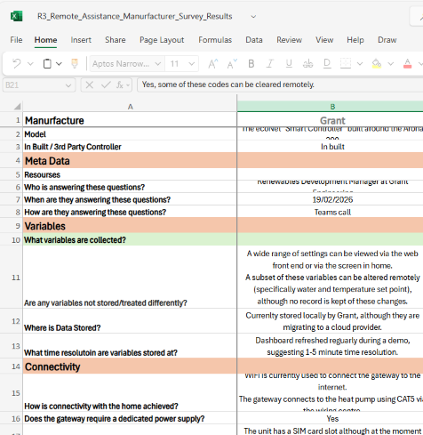

Post installation Action 4:
Mandate monitoring on all installs
Remote monitoring
Remote Assistance
Notes:
The guidance note covers a good introduction to this
Due to the quality issues seen we need to monitor to give ourselves the information to act on issues
The guidance covers things like different options, connectivity considers and more
There is a more detailed log that compares some different manufacturer features as a resource we hope will be updated

Slide 73
Key takeaways
Technical audits are a really valuable learning opportunity
Handover needs skilled people and resources
Monitoring, Monitoring, Monitoring!
Notes:
Auditing is a valuable learning opportunity for us all, shadowing works really well
Handover needs to be done by skilled people
Monitoring monitoring monitoring

Slide 74
Questions

Slide 75
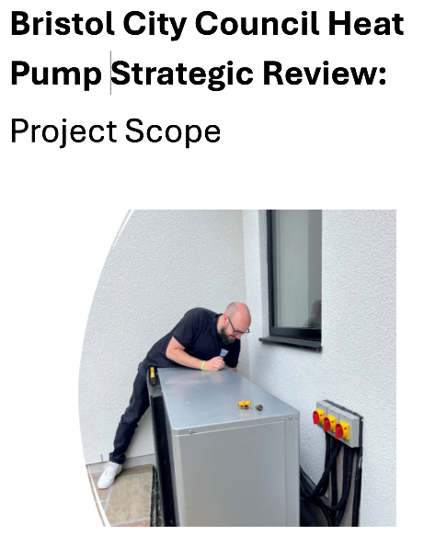
Capture all these actions in a
Strategic Review
Notes:
Obviously there has been a lot covered here and we’ve been doing this gradually over years so we aren’t expecting you to do this all at once!
We’ve actually now just begun a process to bring this all together in a strategic review for which we’ve provided an outline of things to consider. This is very early days though but it might be something to consider.
One thing that is critical is internal stakeholder relations, won’t go anywhere without buy in

Slide 76
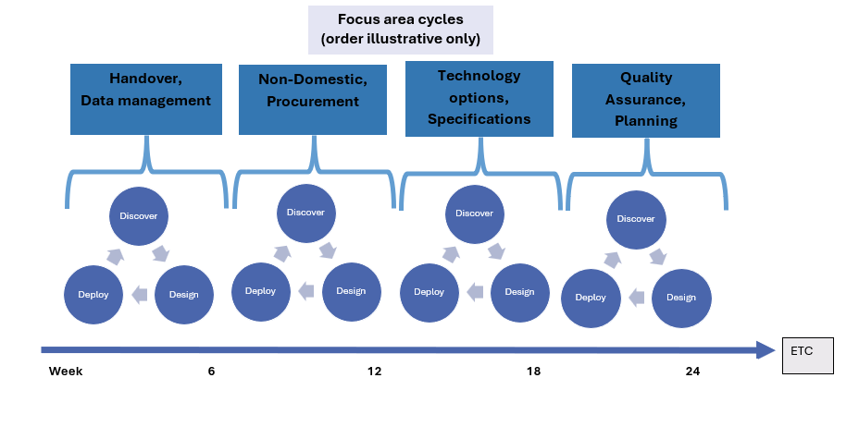
Heat Pump Strategic Review Process
Notes:
As you can see there are a lot of different focus areas we will be tackling this year and taking them step by step
These can be prioritised on the basis of things like urgency and critically capacity amongst consultees to engage in the process

Slide 77
Resources reminder

Slide 78
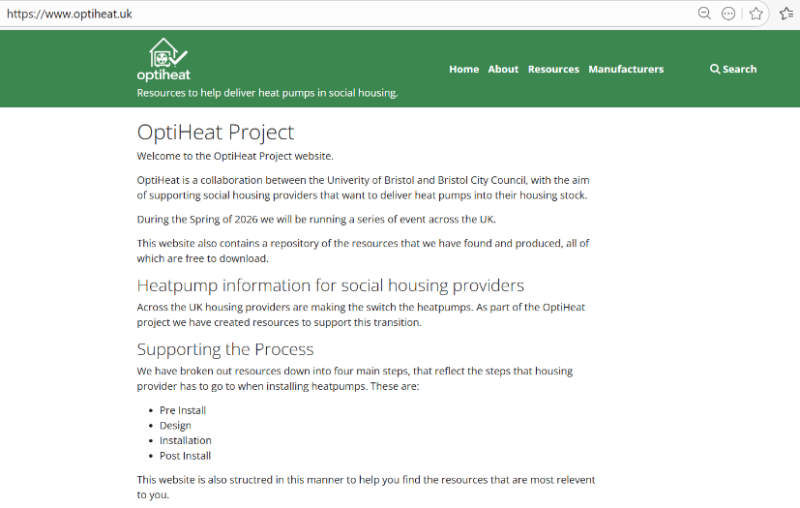
Resources: Website (draft!)
Notes:
Critical to note that we aren’t saying these resources are perfect by a long way and we hope that perhaps a -community of practice will form around keeping them updated
Important that those using resources are willing to learn the why behind them to get the most out of them
We are aiming for bronze here given. Have to be careful of procurement failure or contract disputes that might mean no heat pumps going in at all

Slide 79

Overall quality assurance process
Notes:
It’s for you now to build your own quality assurance process and just to say that it doesn’t matter if you already mid project delivery you still have time to implement these actions.
We have successfully managed to get heat pumps fixed on older installs with the right information saving us a lot of money long term.

Slide 80


Discussion
Notes:
You can make change and most of this doesn’t require any additional resource

Slide 81

Continue the conversations:
Social Housing Heat Pump Delivery Network
(5) Social Housing Heat Pump Delivery Network | Groups | LinkedIn

Slide 82

Have your say!

Slide 83
Additional reference slides
Summary of projects delivered/ delivering
Nesta Heat Pump Audits/ Fixes
Auditing more social housing heat pump installs (39 complete to date)
Learning and recording process
Undertaking fixes to understand costs and impacts
Optiheat Phase 3 (Partners: University of Bristol, Vaillant, Havenwise, Carbon Trust)
Trialling and setting up methodology for remote monitoring and support for heat pumps
Updating resources and materials for heat pump delivery including specification
Sharing learning with other social housing providers nationally
Heat Pump Learning Project (Partners: Green Register, Warmur Training Academy)
Designing and delivering a non-technical heat pump learning programme (delivered autumn 2025)
Technical training for BCC heating engineers and delivery partners
Shaping next phase of training and potential to roll out further
Investigating potential for ‘start at home’ training/ free heat pump for staff with Nesta
Collaborating better with local retrofit businesses to support their growth, diversification and access to resources
Understanding how to better support local businesses including those in the heat pump space better engage with tender opportunities

