Slide 1
August 2025
Decent Homes Standard Webinar (LGA)

Slide 2
Agenda
Time | Item | Led by
Decent Homes Standard Webinar
 | Welcome | Haider Al-Qaddo
 | What is the Decent Homes Standard? | Haider Al-Qaddo
 | Changes to criterion B and C | Haider Al-Qaddo
 | Changes to criterion D (MEES) | Tom Davies
 | The new criterion E | Luke Spanton
 | Implementation | Luke Simpson / Dan Young
 | Exemptions | Luke Spanton
 | Next Steps | Both

Slide 3
Welcome
Welcome to the Decent Homes Standard Review Webinar
Nov 2020 Social Housing White Paper commits to reviewing the Decent Homes Standard
Feb 2021 Part 1 explores the case for change and possible updates with senior SRS stakeholders
Sept 2022 Consultation launches on extending the Decent Homes Standard to privately rented homes
Spring 2023 Part 2 examines specific changes with members of the SRS and PRS
Aims
The aim of today's session is to take you through the main proposals within the consultations for reforming the Decent Homes Standard and introducing Minimum Energy Efficiency Standard into the SRS. We will then be interested in hearing any views you may have on the proposals.
The link to the DHS consultation is here: Consultation on a reformed Decent Homes Standard for social and privately rented homes - GOV.UK
The link to the SRS MEES consultation is here: ​​Improving the Energy Efficiency of Socially Rented Homes in England - GOV.UK

Slide 4
What is the Decent Homes Standard?
The DHS is the minimum standard for physical decency that social homes are required to meet
Overview of the DHS
The four criteria that make up the current DHS
The Decent Homes Standard was first published in 2001 and updated again in 2006.
The DHS sets the minimum standard to which all SRS properties (HA-owned and LA-owned) are to be held to.
There are four criteria that make up the DHS (see table opposite).
In 2006 the DHS was updated, introducing the requirement for homes to be free from the most dangerous ‘category 1’ hazards, assessed using the Housing Health and Safety Rating System (HHSRS). The HHSRS does not set a minimum standard, but instead assesses and categorises hazards in residential premises by seriousness.
Last month, we launched consultations into reforming the current DHS and introducing it into the PRS for the first time and a consultation on SRS MEES.
A
Criterion A – It meets the current statutory minimum standard for housing
HHSRS - Free from cat 1 hazards
B
Criterion B – It is in a reasonable state of repair
No key building components are old and in poor condition
No more than one other key building component is old and in poor condition
C
Criterion C – It has reasonably modern facilities and services
Lacks no more than 2 of a list of facilities, including reasonably modern kitchen (<20 years old) and bathroom (<30 years old)
D
Criterion D – It provides a reasonable degree of thermal comfort
Has both effective insulation and efficient heating

Slide 5
Summary of proposals for consultation
Criterion | Current DHS | Potential updates for DHS
Criterion A | A dwelling must be free of hazards at the most dangerous ‘category 1’ level | No changes
Criterion B | A property fails if one or more key building components are old and in disrepair; or two or more other building components are old and in disrepair | Failure is based solely on the condition of components, not the condition and their age The lists of key and other building components are expanded
Criterion C | A property fails if it lacks three or more facilities, e.g. adequate kitchen which is less than 20 years old or bathroom which is less than 30 years old | Properties must provide at least three of the core facilities to be decent. Bathroom and kitchen age is no longer a reason for failure Window restrictors added to list of essential facilities Potential additions: Consider if secure doors and windows be added to the list of essential facilities. Consider if floor coverings should be provided at the start of a tenancy
Criterion D | A dwelling must have both efficient heating and effective insulation | A dwelling must meet relevant Minimum Energy Efficiency Standards (consultation separate) and have programmable heating
Criterion E (new) | No specific damp & mould requirement | Landlords should ensure their properties are free from damp and mould.

Slide 6
Changes to criterion B & C

Slide 7
Disrepair
Criterion B of the DHS requires properties to be kept in a reasonable state of repair
Updates
Decent Homes Standard - Criterion B
Key: New/updated requirement Existing requirement
A dwelling satisfies this criterion unless:
One or more key building components is not in a reasonable state of repair and
Two or more other building components are not in a reasonable state of repair
Components no longer need to be old as well as in disrepair to fail
The definition of disrepair is simplified to be more descriptive
New building components are brought in scope
Key building components:
Other building components:
External walls
Roof structure
Roof covering
Windows
External doors
Chimneys
Heating systems
Kitchens
Bathrooms
Lifts
Internal doors
Fire alarm systems
Fire safety signage
Sprinkler systems
Internal finish
Rainwater goods
Mechanical ventilation
Balustrades
Handrails and stair-treads
Boundary walls
Door entry systems
SRS only:
Curtilage
Pathways and steps
External lighting
Bin stores
Removal of ‘age’ from building components so that failure is based solely on the condition and not how old the component is.
The list of existing components should be expanded to include fire alarm systems, sprinklers, fire signage, lifts, rainwater goods door entry systems and handrails/stair threads.
Amend the definition of disrepair from what we think is currently too prescriptive to a simpler descriptive definition.
Updating ‘key’ and ‘other’ distinction for components listed (see diagram). Notably, adding kitchens and bathrooms to ‘key components’ as we remove the age profile from criterion C.

Slide 8
Facilities and Services
Criterion C of the DHS requires properties to have reasonably modern facilities and services
Updates
Decent Homes Standard - Criterion C
Key: New/updated requirement Existing requirement
A dwelling must provide three of the following core facilities:
a kitchen with adequate space and layout
an appropriately located bathroom and WC
adequate external noise insulation
adequate size and layout of common entrance areas for blocks of flats
Landlords must also:
Provide child-resistant window restrictors on wide opening windows above the ground floor
We are also:
Considering adding secure doors and windows to the list of essential facilities.
Considering requiring floor coverings at the start of a tenancy
Age is no longer a reason for failure
Properties must contain 3 out of 4 core facilities
Window restrictors added; considering evidence for security and floor coverings

Slide 9
Criterion D (MEES)

Slide 10
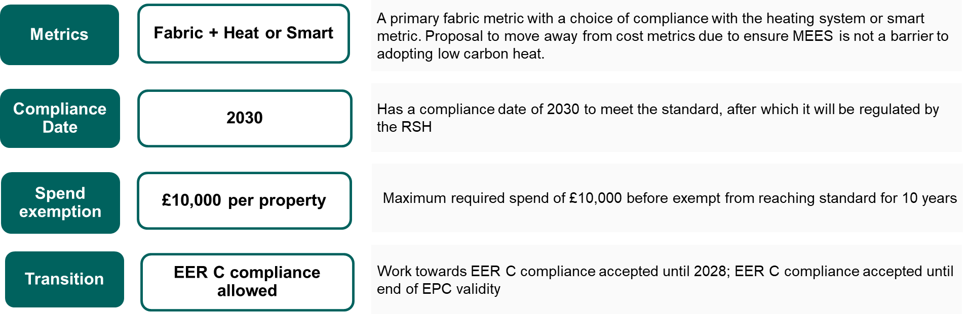
Overview of Criterion D and SRS MEES
The background and overview of MEES for the social rented sector
​SRS MEES will be included in the revised Decent Homes Standard (DHS) as part of a Criterion D on thermal comfort (alongside the requirement for adequate and programmable heating systems), setting the standard at EPC C or equivalent. We are current consulting on SRS MEES until 10th September 2025.
Preferred positions for MEES

Slide 11
Metric Options
Overview of the options in the SRS MEES consultation
Government Preferred Option – Fabric + Smart or Heat
Option 2 – Single Metric Approach: Fabric Performance
Less fuel poverty reductions, bill savings and carbon savings compared to options with second metric.
Fabric improvements to improve the thermal comfort, reduce energy bills, reduce risk of damp and mould.
Option 3 – A Requirement to Meet a Standard Set Against Specified Dual Metrics
Options 4A and 4B – Allowing Providers Maximum Flexibility in which Standards they Meet
No government preference.
Risk that the measures installed may not be the most effective in maximising energy use potential or in reducing the fuel costs to benefit residents.
Option 4A- Providers would need to meet an average standard, set at EPC C or equivalent, across the three metrics (fabric, smart and heat).
Option 4B- A minimum standard equivalent to band C is set against all three metrics. Provider choose two metrics to meet MEES

Slide 12
Compliance Date
Proposed compliance date for SRS MEES
2030 (Government preferred date)
Alternative dates
Proposed compliance date for SRS MEES is 2030.
Gives the sector time to review existing plans, secure investment and complete works.
Many providers are already working towards achieving EER C by 2030.
Supports meeting Government’s 2030 statutory fuel poverty target, and commitments to deliver carbon savings towards the fifth carbon budget (2028-32).
Earlier than 2030
Setting a compliance date any earlier that 2030 would be challenging for delivery.
Later than 2030
Would give providers more time to prepare to meet MEES but would delay tenants receiving benefits of warm homes.
Estimates suggest compliance date later than 2030 would not materially affect the overall cost of MEES to the sector.

Slide 13
Time-Limited Spend Exemption
Overview of spend exemption for SRS MEES
Proposed to provide protection in cases where the cost of compliance is unusually high, in addition to the exemptions in the DHS.
If a provider spends a set amount on energy efficiency and/or other relevant measures and the property has still not met MEES, the property would be seen as exempt for a set period.
Time-limited spend exemption would last for 10 years from the MEES compliance date.
£10,000 (preferred option)
Support providers in working towards compliance with MEES, while helping to tackling fuel poverty and reduce household carbon emissions
Help providers manage financial pressures and competing housing priorities.
The average cost per home is often significantly lower than this threshold.
£15,000
May enable more homes to meet MEES standards, enhancing the benefits for tenants.
Could present higher costs overall for some providers (despite lower average upgrade costs per property).
£15,000 would align with Government’s preferred approach for PRS MEES.
No spend exemption
Set no spend exemption for SRS MEES.
Would require providers to meet MEES for all properties, regardless of the cost per property.
Maximises the benefits for tenants but would be a significant financial burden on some providers

Slide 14
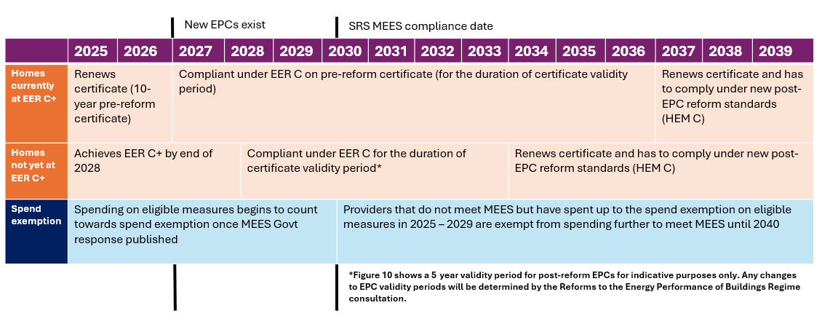
Proposed Transition Approach and Timeline
Proposing a transition period that recognises early action and provides reasonable flexibility
This approach means that all social homes must achieve some form of EPC C by 1 April 2030, other than those for which there is a valid exemption.

Slide 15
The new criterion E

Slide 16
Damp & Mould
A new criterion E will require that properties be free from damp & mould
Criterion E: Damp & mould
Why are we introducing this?
Landlords should address damp and mould when it is reported. They do not need to carry out a detailed assessment to do this.
If damp and mould poses a serious health risk, Awaab’s Law will apply
Enforcement / regulatory decisions will be based on the Housing Health & Safety Rating System (HHSRS)
Damp & mould can have serious health effects. The coroner’s report into the death of Awaab Ishak highlighted the DHS’s weakness on damp & mould
Rented homes are the most likely to have damp & mould (9% PRS; 7% SRS). Everyday tasks will produce moisture, but tenants cannot reduce moisture levels if their home does not allow them to do so.
The DHS needs to be more preventative, robust and explicit on expectations for landlords around damp and mould
Landlords must tackle the structural causes of damp & mould, such as poor ventilation, excess cold, or building deficiencies. It is not acceptable to blame tenants’ ‘lifestyle choices’
It may be beneficial to work with tenants to help them make small, reasonable adjustments to their behaviour, if appropriate, to reduce their damp and mould risk

Slide 17
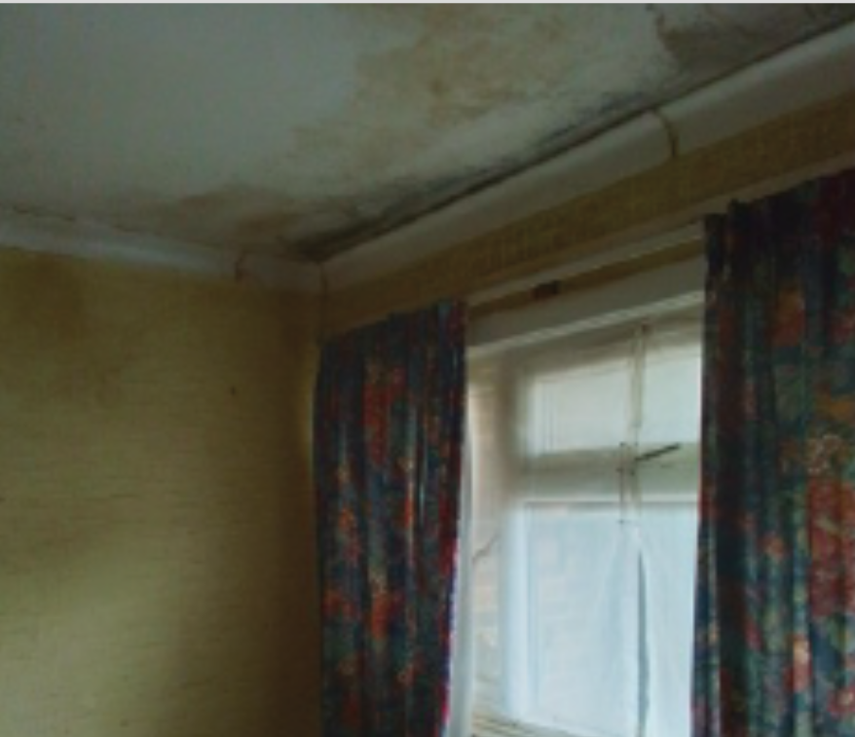
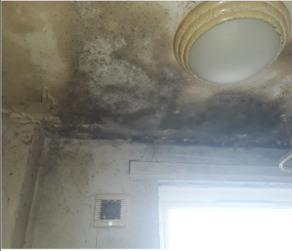
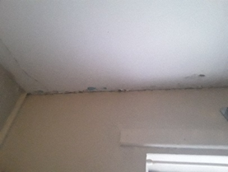
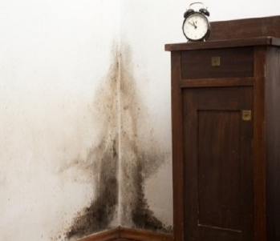
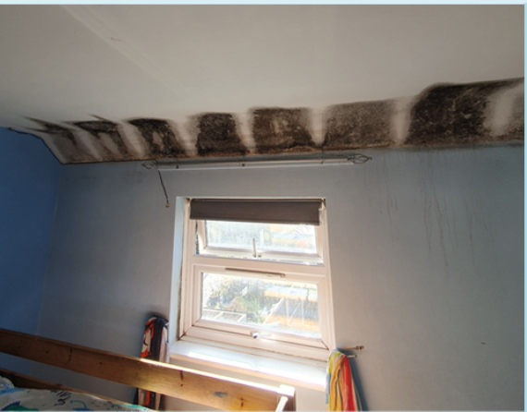
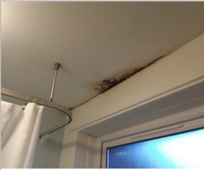
Damp and Mould: What does failure look like?
A property will fail the DHS if it contains damp & mould within HHSRS bands A to H
In all of these examples, landlords should take action now
Landlords should always address damp and mould. They do not need to do an HHSRS assessment (but can if they wish).
The HHSRS rates hazards based on the risk of harm in bands from A (most dangerous) to J (least dangerous)
These properties will fail the DHS
Regulators will use an HHSRS inspection to determine whether these properties fail the DHS
Regulators will ascertain if a property has failed the DHS if it has damp & mould within bands A to H of the HHSRS.
An HHSRS assessment evaluates the risk of harm and uses this to rate the seriousness of any hazard identified, generating a score that falls into one of ten bands from A-J, with A the most dangerous and J the safest.
We are not proposing that landlords carry out HHSRS assessments. Instead, they should simply address damp and mould when it is reported.
But, for information purposes only, these two examples are likely not to fall within Bands A to H (an HHSRS assessment of the whole property would be necessary to be certain).

Slide 18

Damp and Mould: Guidance
Guidance will be help landlords meet the new requirement
We will produce extensive guidance for landlords on the DHS, including damp & mould
This will complement existing guidance on damp & mould:
MHCLG and Department of Health and Social Care guidance on the health risks of damp & mould
Primarily aimed at social and private rented housing providers
Helps to improve standards in rented homes and prevent harm to tenants.
Royal Institute of Chartered Surveyors consumer guide on damp and mould
Helps owners and occupiers of residential property to manage and maintain their homes.
Baily Garner practical toolkit for diagnosis and treatment of damp and mould
An example of guidance developed by industry and academia.
Sets out how to diagnoses causes of dampness, next steps, property archetypes and case studies.

Slide 19
Implementation of the DHS in the SRS

Slide 20
DHS Implementation
2025
2026
2027
2028
2029
2030
2031
2032
2033
2034
2035
2036
2037
EPC C
DHS Option 1
DHS Option 2
Electrical Safety Phase 2
C&C Standard in force
C&C transition period ends (small RPs)
Access to information Phase 1
Access to information Phase 2
Electrical safety Phase 1
C&C Transition ends (large RPs)
EPC C (all tenancies)
DHS Option 2
Cat 1 hazards £7k fines
Renters Rights Bill Phase 2
EPC C (new tenancies)
DHS Option 1
Awaab’s Law Phase 1
Awaab’s Law Phase 2
Awaab’s Law Phase 3
Renters Rights Bill Royal Assent (subject to Parliament)
Timeline of quality reforms for rented housing
SRS
PRS
Awaab’s Law dates TBC – subject to consultation
20

Slide 21
Implementation of the DHS in Social Housing
The Regulator of Social Housing will implement the DHS in 2035 or 2037
When will the DHS come into force?
The DHS will apply to social housing from either 2035 or 2037.
How will the DHS be implemented in social housing?
The DHS will continue to be implemented by the Regulator of Social Housing.
Landlords have new regulatory pressures and are responsible for new housing
We will confirm the standard by the end of the year
Why have we chosen these dates?
The timeframe is comparable to the original DHS implementation period.
Will residents have to wait until 2035 to see change?
Limited exemptions will apply
Awaab’s Law and MEES will apply ensure tenants are comfortable and safe in their homes.
We expect to see a steady improvement in social housing quality

Slide 22
Implementation of the DHS in Private Rented Housing
Local councils will begin enforcing the DHS in full from 2035 or 2037
When will the DHS come into force?
The DHS will apply to private housing from either 2035 or 2037.
How will the DHS be implemented in private housing?
The DHS will be enforced by local authorities, in line with current HHSRS arrangements.
We will confirm the standard by the end of the year
Why have we chosen these dates?
The timeframe is comparable to the original DHS implementation period.
Will residents have to wait until 2035 to see change?
No exemptions will apply. Councils will have discretion in enforcement
Fines for serious failures, MEES, and Awaab’s Law (subject to consultation), will ensure tenants are safe and comfortable in their homes.
We are seeking views on phasing in some elements of the DHS earlier
We are prioritising rental reform, safety and energy efficiency in the short term

Slide 23
Meeting the standard, or exemptions (DHS)

Slide 24
What if it’s not possible to meet the DHS?
Systems for managing compliance with the DHS should provide flexibility
Meeting the standard
What are we proposing?
It will be possible for most properties to meet the DHS.
Individual circumstances may make it prohibitively hard or impossible to meet certain elements of the standard
We will provide flexibility to account for these circumstances.
The approach to exemptions will reflect differences between the tenures
It is important to recognise the rights and concerns of tenants, particularly those who may be vulnerable.
In the SRS, social landlords will continue to declare the number of properties which they assess are exempt to the Regulator of Social Housing.

Slide 25



Why might a property not be able to meet the DHS?
Exemptions will vary by tenure
Social Rented Sector
DHS implemented by the RSH through its consumer standards
Private Rented Sector
Failure to meet DHS enforced by local authorities
Specific exemptions
Tenant refusal
Enhanced guidance to be provided
Physical factors
Sale, demolition, regeneration
MEES exemptions
Permissions
Planning, conservation, freeholders
LAs have discretion to consider the best course of action
This is in line with their current enforcement of the Housing Act 2004
Statutory guidance will set out examples
Tenant refuses access
Physical factors
Planning factors
Question: Are these the right ways to address cases where it’s not possible to meet the DHS?

Slide 26
Next Steps

Slide 27


Upcoming Activity
Next steps
Next Steps
The DHS and SRS MEES consultations are currently live until 10 September. We could encourage you and those you represent to complete these before the deadline.
We have committed to publishing an updated DHS and setting out SRS MEES by the end of the year. We will publish technical guidance and government responses to accompany these new standards.
Contact
If you would like a follow up conversation or to submit feedback, please contact us at: DecentHomesReview@communities.gov.uk
SRS.MEES@communities.gov.uk

